Slide 1
INTRODUCTION
Crime is one of the biggest and dominating problem in our society and its prevention is an important task
Chicago has been in the news a lot in the last few years especially due to the recent up surge of murders resulting from gun violence
The objective of this project is to analyze dataset which consist of numerous crimes and clustering the districts with the similar types of crime trends
Before training of the model data we shall be performing Data Analysis using Pandas and Visualizations libraries to understand tends and patterns of the crimes which are been committed
We shall then use Foursquare APIs to come up with more insights about the locations in which various crimes are getting committed.

Slide 2
DATASET
In this project, we will be using the technique of machine learning and data science for crime prediction of Chicago crime data set
The crime data is extracted from the official portal of Chicago police. The data is publicly available data from the City of Chicago’s data portal linked below to explore crime in Chicago from January 2001 to February 2018
Data Sources:
https://data.cityofchicago.org/Public-Safety/Crimes-2001-to-present/ijzp-q8t2
https://data.cityofchicago.org/Public-Safety/Boundaries-Police-Beats-current-/aerh-rz74

Slide 3
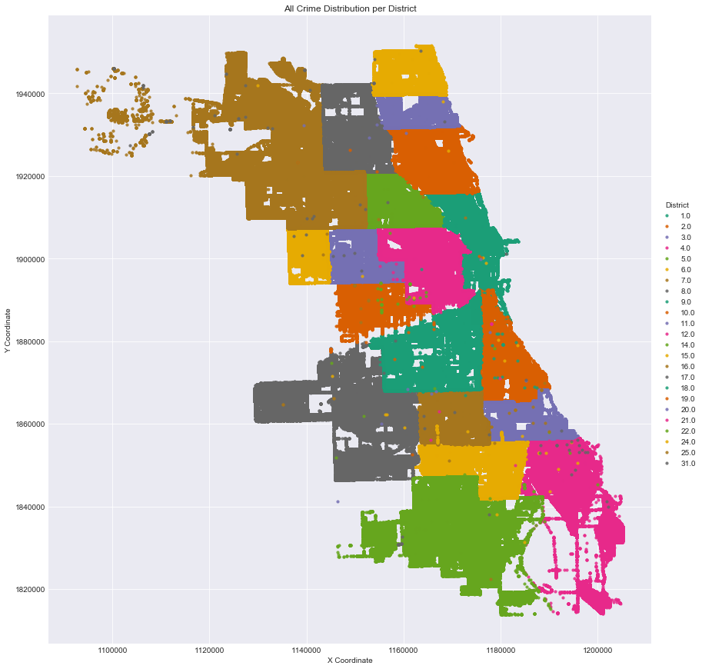
DATA ANALYSIS
Crime in general is distributed across the whole city. For this a scatter plot is created mapping all crime geo locations (X and Y coordinates) in the dataset and plotted it on the city's geographic map

Slide 4
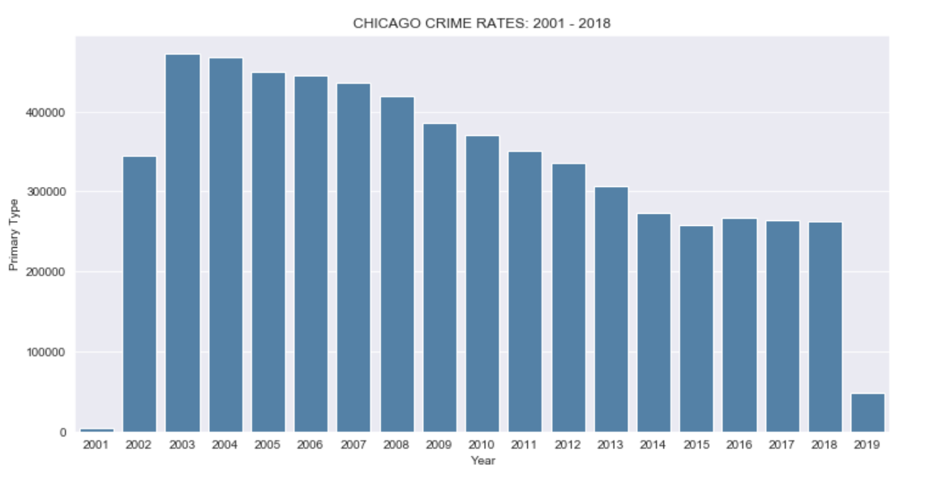
DATA ANALYSIS
We see that the trend on the decrease in the crime count continued till 2015 post that again there has been a slight spike in the crime counts and the crime rate has not been decreasing further

Slide 5
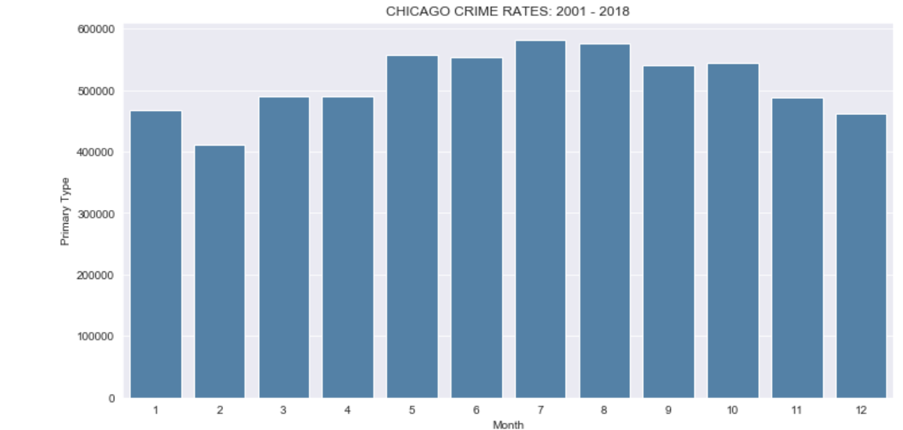
DATA ANALYSIS
We see that crimes tend to spike during summer months from May-August, and we see the least crime during the holidays of Christmas-New Year

Slide 6
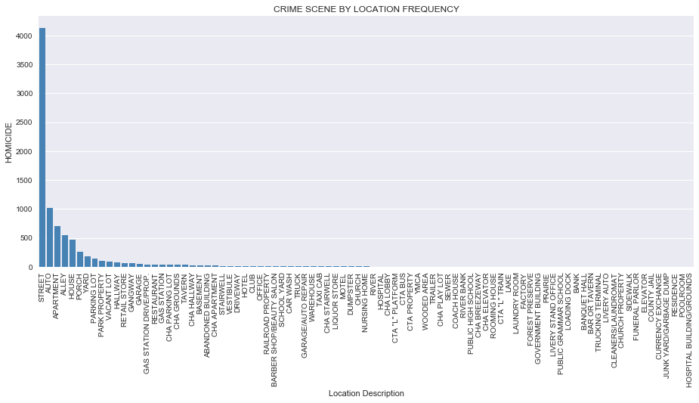
DATA ANALYSIS
From our Seaborn FactorPlot above, we can observe that majority of the murders (more than 60%) happen on the street. So it seems that street are no safe in Chicago

Slide 7
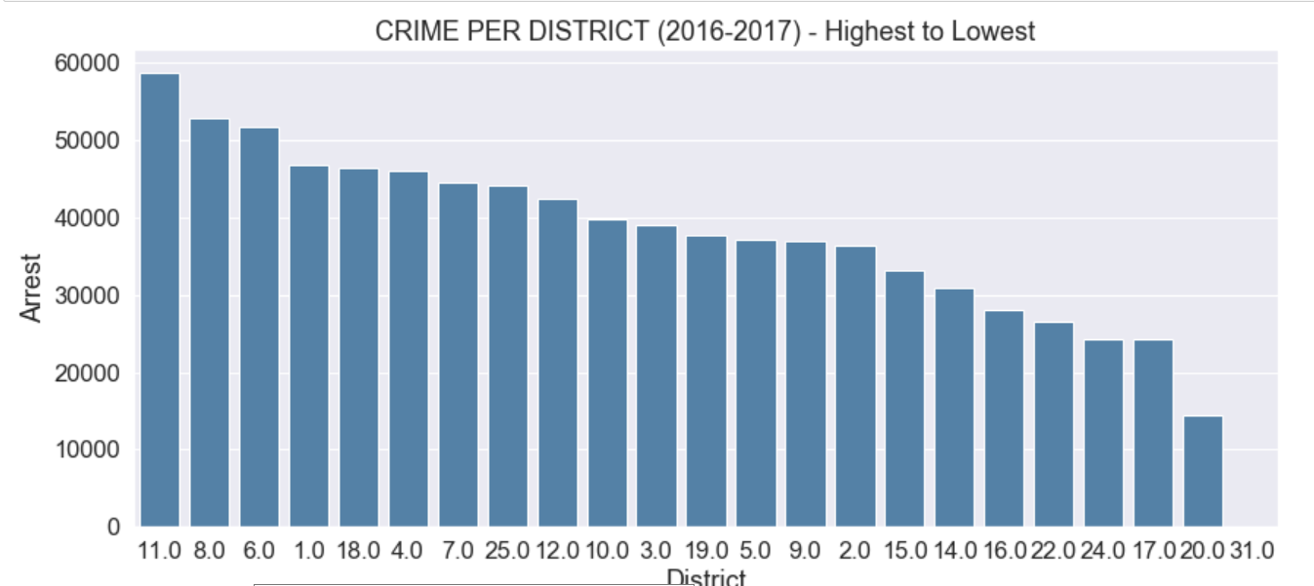
DATA ANALYSIS
District 11, 8 and 6 are the ones most prone to crime and the districts 17,20 and 31 being the ones with the least crime rate.

Slide 8
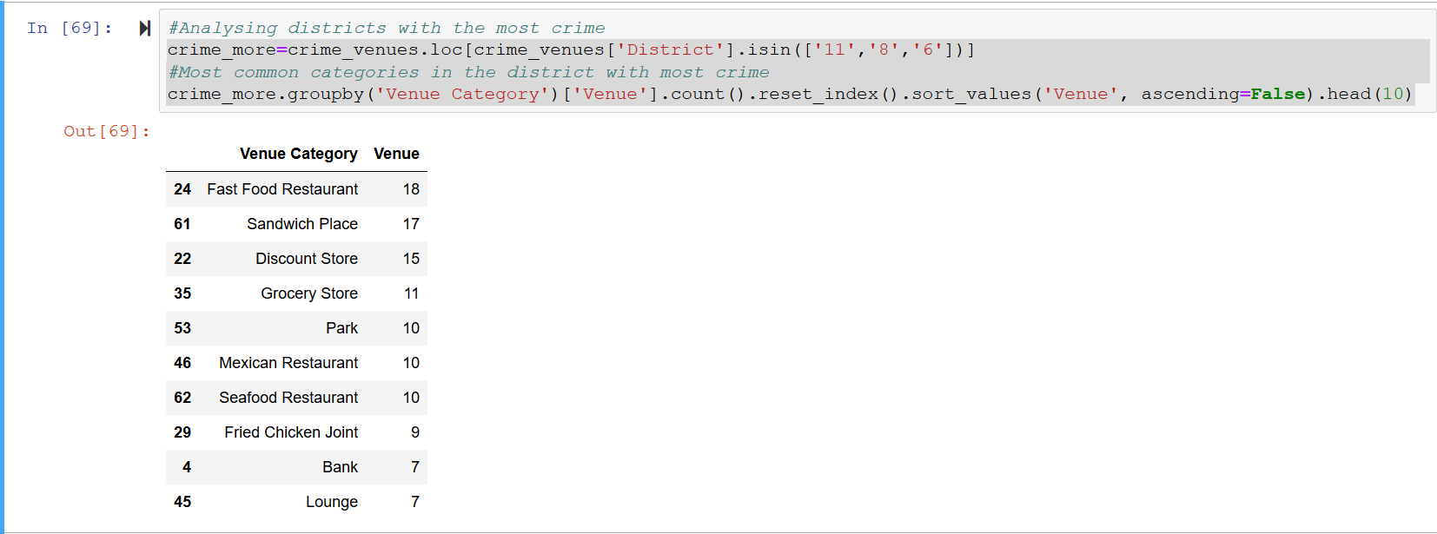
DATA ANALYSIS USING FOURSQUARE API
During our exploratory analysis we found that district 11, 8 and 6 were the ones with the most crime rates. Let us see the most common venues in these districts and their categories.

Slide 9
Clustering Using K-Means
We use K-Means clustering to cluster the districts based on their location as well their crime count
Once we examine the Clusters we get the insight that the Cluster 0 and 1 comprise of the districts with high crime count and they are close to each other, similarly the rest of the clusters have lesser crime counts.
We further examine the clusters and check the 10 most common venues in them.

Slide 10
CONCLUSION
The key findings can be distilled to a few key points below:
The number of crimes vary greatly by police district. Districts with high numbers seem to always have high numbers year after year and vice versa.
Crime numbers were largely unchanged from 2014 to 2018 which is a good thing and the Chicago PD must be congratulated for this.
There is a correlation between weather temperatures and number of crimes per month. The warmer the month, the more crimes are committed.
Day of the week also affects how many murders are committed with weekends seeing higher numbers.
Time of the day also affects the amount of crimes committed with 9pm to 2am being the most dangerous and 7am to 1pm being the safest hours.
District 11, 7 and 15 had the highest homicides in 2016–2017 period
An overwhelming majority of crimes are committed on the street accounting for more than 60% of all crime scenes.
We also had a picture as to what kind of venues are common in the districts having a high crime count and the districts having a low crime count.

